Slide 1

Lifespan Psychology: Adolescence
AEPSY Year 11 ATAR Psychology

Slide 2
Review
Define neural blooming and neural pruning.
What are the functions of the frontal lobe of the cerebrum?
Explain why child development is described as organised and sequential.
What are the “four pillars” of child development milestones?
Give an example of each that an infant and child might demonstrate.

Slide 3
Review
6. Draw an interneuron.
7. Where in the nervous system would these be located and what is their function?

Slide 4
Learning Intentions
Lifespan psychology
developmental stages across the lifespan – adolescence
changes across developmental stages
physical (gross and fine motor skills)
cognitive (language)
social and emotional development

Slide 5
Success Criteria
Define neural pruning and give examples.
Describe key changes to the adolescent brain.
List cognitive and social-emotional changes that are associated with adolescence.

Slide 6
Adolescence
In pre-industrial society, children were considered adults when they reached physical maturity, but we now acknowledge the period of development between childhood and adulthood.

Slide 7
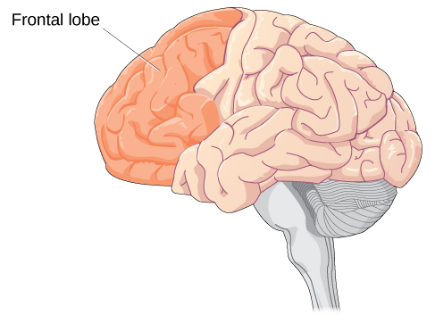
The adolescent brain
Up until puberty, brain cells continue to bloom in the frontal region. Adolescents engage in increased risk-taking behaviors and emotional outbursts because the frontal lobes (responsible for judgment, impulse control, and planning) of their brains are still developing.

Slide 8
Cognitive
More complex thinking abilities emerge during adolescence, due to increases in processing speed and efficiency —in other words, due to improvements in existing skills rather than development of new ones.

Slide 9
Social - emotional
Teen thinking is characterized by the ability to consider multiple points of view, imagine hypothetical situations, debate ideas and opinions (e.g., politics, religion, and justice), and form new ideas. In addition, it’s not uncommon for adolescents to question authority or challenge established societal norms.

Slide 10
The Teenage Brain | PBS LearningMedia

Slide 11
Cognitive empathy begins to increase in adolescence and is an important component of social problem solving and conflict avoidance.

Slide 12
Adolescents continue to refine their sense of self as they relate to others. As adolescents work to form their identities, they pull away from their parents, and the peer group becomes very important. Despite spending less time with their parents, most teens report positive feelings toward them.
Only small numbers of teens have major conflicts with their parents, and most disagreements are minor.

Slide 13
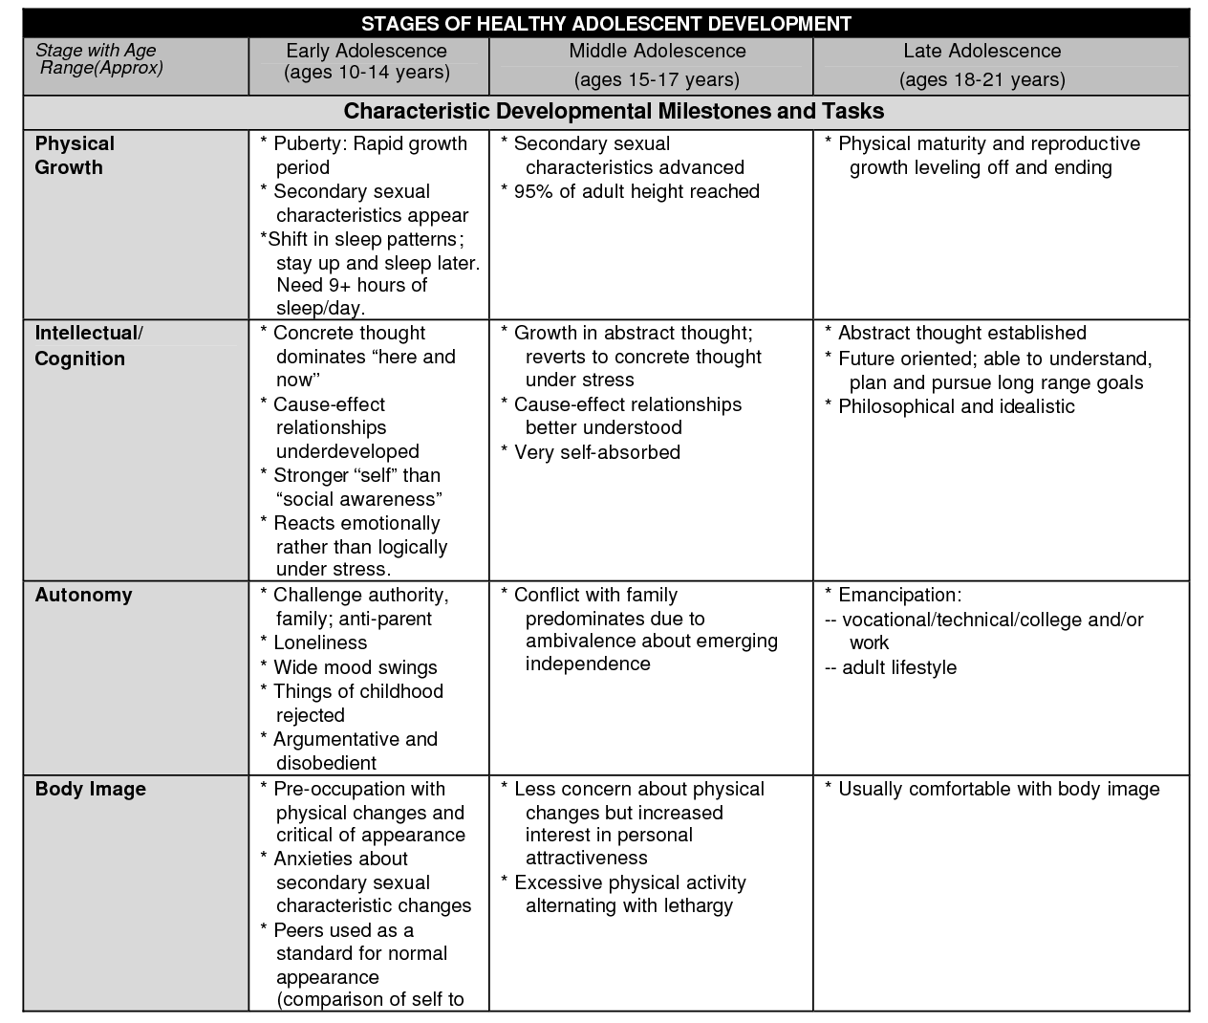

Slide 14


Slide 15
Success Criteria
Define neural pruning and give examples.
Describe key changes to the adolescent brain.
List cognitive and social-emotional changes that are associated with adolescence.

